Slide 1


Module 5:
Test Automation Frameworks
by Uladzimir Zviartouski
AUGUST 5, 2016

Slide 2



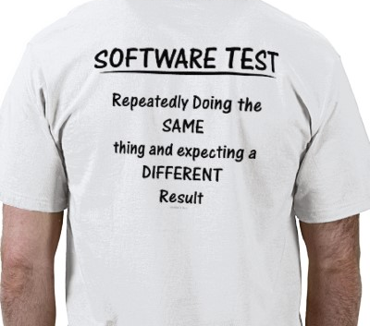

FEW WORDS ABOUT ME
5+ years with EPAM
ULADZIMIR ZVIARTOUSKI
Lead Software Testing Engineer

Slide 3
AGENDA
Test Automation Challenges (when we need framework to approach)
Test Automation Framework Meaning
Test Automation Approaches
High Level Architecture
How To Start Test Automation Framework
Test Automation Framework Design
Introduction To Patterns
Notes:
P37 – divide into 2 slides

Slide 4
Test automation
challenges

Slide 5
TEST AUTOMATION CHALLENGES
SDLC:
BA
DEV
QA
Auto QA
SDLC Challenges:
Agile development
Architectural (technology, environment, business logic, CD, scale) adjustments
Test design, test strategy adjustments
Notes:
P37 – divide into 2 slides

Slide 6
TEST AUTOMATION CHALLENGES
Test Automation Challenges:
Not reliable test results
(instability, lack of reporting)
QA productivity degradation
Test coverage gaps (bugs leakage to prod)
Effort duplication
Support overhead
Testing resource too expensive
to scale, when required

Slide 7
SUMMING UP
Test Automation Framework Helps:
1
Increase repeatability of smoke, acceptance and regression tests
2
Save time for complicated and repeatable tasks
3
Adopt test strategy into CD
4
Save time for cross platform testing
5
Speed up data-driven testing

Slide 8
Test automation
Framework meaning

Slide 9
TEST AUTOMATION FRAMEWORK MEANING
Challenge
Knowledge
Skills
Solution
Idea
Framework
Tip:
Framework provides interface and reusable components to get your idea to solution

Slide 10
TEST AUTOMATION FRAMEWORK MEANING
Your ideas expressed with code and data according to framework interface
Code/
Data/
Configuration
Implemented to interface/
model
Executes/
Process/
Apply
SDK
Use realization
Framework
Tools,
Libraries,
Languages
Abstract Model, Interfaces, Approach
Utilities
Controllers
Executers

Slide 11
SUMMING UP
Test Automation Framework meaning is:
1
Keep architecture, test approaches of the solution in place
2
Save time for complicated and very repeatable tasks
3
Adopt test strategy into CD
4
Save time for cross platform testing
5
Hide complexity behind simple interface, decouple data from code
6
Concurrent run, configuration management, reusability of code/approach

Slide 12
Test automation
Approaches

Slide 13

TEST AUTOMATION APPROACHES
Frameworks
Record & Playback
Scripts
Keyword-Driven
Data-Driven
Behavior-Driven
Hybrid Framework

Slide 14
TEST AUTOMATION APPROACHES
 | Pros | Cons
Record And Playback | Fast way to transform manual script and repeat it | Time to get automated script = manual run time If script need to be changed = need record again State, Image dependent, not scalable, not configurable
Scripts | Fast way to automate tasks/steps/actions | Not scalable Code duplication Hard to manage, poor readability Hard to debug
Keyword-Driven | QA automate tests along with test plan Extendable to Data-Driven | Hard to manage Hard to debug Changes in keyword affects many test cases
Data-Driven | Automates a lot of test cases with single scenario code | In terms of SUT changes require change many data Hard to keep data consistent
Behavior-Driven | Business oriented Domain oriented Clear reporting and tractability Data-Driven | Hard to scale Requires a lot of consolidation Hard to maintain Overhead if Business not Involved
Hybrid | Agile | More complexity More point of failures

Slide 15
KEYWORD-DRIVEN + DATA-DRIVEN
Action | Keyword | Object | Type | Data
Login | Input | Username | Text | ${username}
Login | Input | Password | Text | ${password}
Select Product | Click | Checkbox | Label | ${productName}
Put To Cart | Click | Button | Label | “Order”
Assert Cart | Assert | Element | ProductItem | ${productName}
Paramenter | TestCase1 | TestCase2
username | usauser | ukuser
password | changeme | changeme
productName | iphone6 | iphon6

Slide 16
KEYWORD-DRIVEN + DATA-DRIVEN
Model
Table
Controller
Executor
Config
Context Manager
Data Provider
Reporter
Test Data

Slide 17
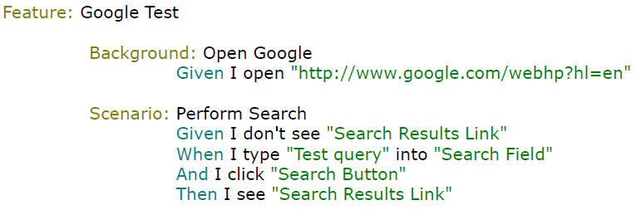
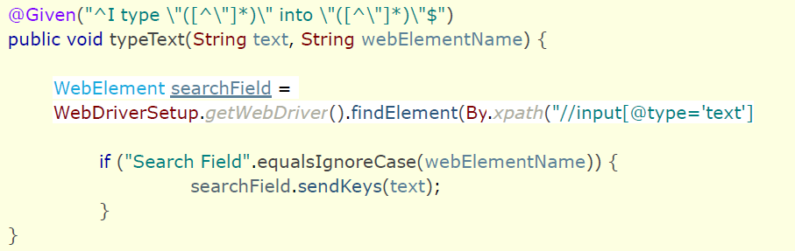
BEHAVIOUR-DRIVEN

Slide 18
HYBRID
KDD
BDD
UNIT
DSL

Slide 19
SUMMING UP
Test Automation Approaches:
1
Framework provides several approaches to write test using common components
2
Framework provides abstraction to implement concrete task and hide complexity
3
Framework provides DSL to write code in SUT entities and operations
4
Framework expose reusable components (page objects, steps, assertions)

Slide 20
HIGH-LEVEL ARCHITECURE

Slide 21
HIGH-LEVEL ARCHITECTURE
Browser
Mobile Device
Web Service
Browser
Appium
WebDriver
HttpClient
Context
PageObjects
ServiceAPI
Steps/Business Objects
Reporter
Runner

Slide 22
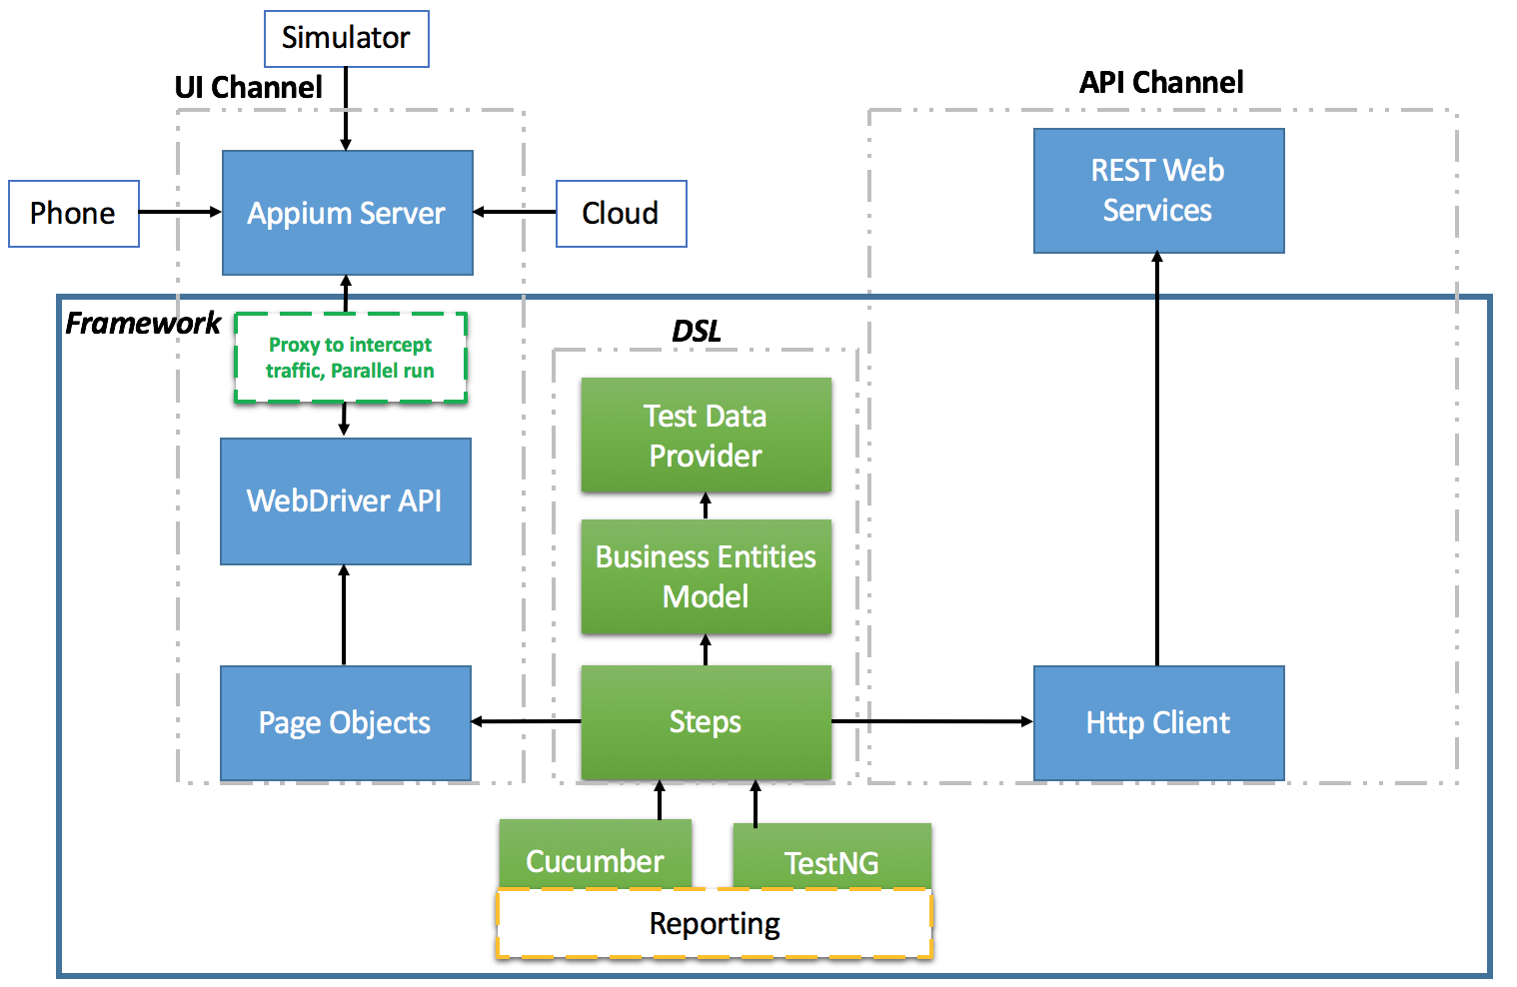
EXAMPLE

Slide 23
SUMMING UP
Architecture includes:
1
Data Provides and implementation to read from different sources
2
Application channel – Browser, Mobile Device, Web Service
3
DSL – Business Objects, Steps, Services
4
Utilities – Assertions, Error Handling
5
Reporter
6
Configuration and Context Management – concurrency, DI, Builders, Factories

Slide 24
HOW TO START
TEST AUTOMATION
FRAMEWORK

Slide 25
START TA FRAMEWORK
Discover UI -> Design Page Objects
Implement Page Objects (with locators)
Implement Business Objects/Steps
Define Data Provider
Implement Configuration (browsers, concurrency, timeouts)
Add Logger
Set up reporting
Adjust to CI

Slide 26
TEST AUTOMATION
FRAMEWORK DESIGN

Slide 27
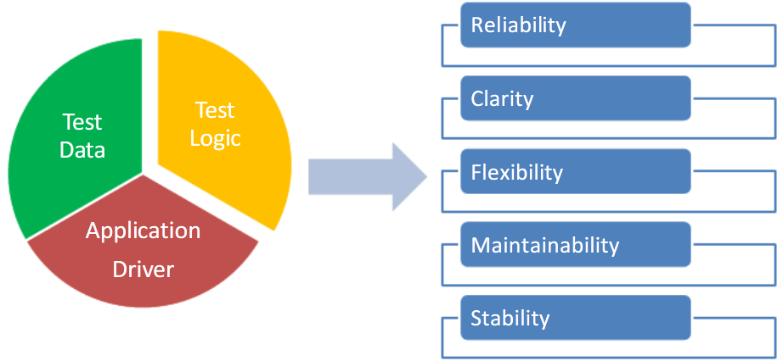
TEST AUTOMATION FRAMEWORK DESIGN

Slide 28
TEST AUTOMATION FRAMEWORK DESIGN
Goal: Test case/test steps abstraction
Test case:
Confirmation after submitting a trade
Steps:
Login to trading system (uk_user/uk_password)
Create new trade (type – sale, counterparty – US, commodity – oil, amount – 2 tonns)
Confirm the trade
Expected result:
1. Confirmation email received
Test script:
testReceiveConfirmationAfterSubmittingTrade()
Test steps:
loginSystem(user, password)
createTrade(type, counterparty, commodity, amount)
confirmTrade(trade)
confirmationReceived(username, password)

Slide 29
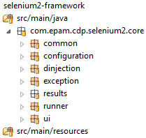
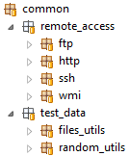
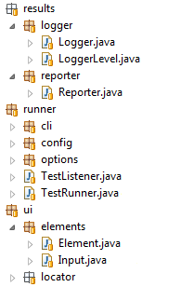
TEST AUTOMATION FRAMEWORK DESIGN
Core
Framework configuration
Common libraries
Exception handling module
Reporting
module
Test manager (Runner)
UI Testing module

Slide 30
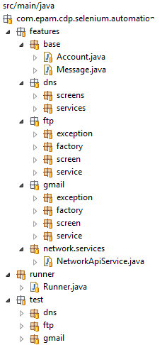
TEST AUTOMATION FRAMEWORK DESIGN

Slide 31

TAF : TOOLS, DESIGN, RESOURCES
For more framework examples
and project best practices in particular case
Please address Test Automation CC:
Org Competency Automated Testing <OrgCompetencyAutomatedTesting@epam.com>

Slide 32
TAF : TOOLS, DESIGN, RESOURCES
Some tips from public resources:
https://github.com/atinfo/awesome-test-automation/blob/master/java-test-automation.md - List of tools/libs to build a custom framework (sorry, Java only ☹, try to map this for .NET ecosystem ☺).
http://menonvarun.github.io/taf/ - some more theory and github project linked.
https://opencredo.com/test-automation-quickstart-framework/ - TAF for possible project quick start with github project linked.
Please consider license/legal topics
when applying for real projects!

Slide 33
HOMETASK
Update your automated tests from previous module (WebDriver) with new project structure:
Create packages for page objects, tests, steps, business objects, utils.
Create business objects as Java/C# classes and use them in your tests (e.g. user with 2 parameters - name and password).

Slide 34
INTRODUCTION TO OOP DESIGN

Slide 35
<SPOILER> FOR PATTERNS ☺
Understand OOP principles (SOLID)
Understand how Java address it (Encapsulation, Inheritance, Polymorphism)
Take pattern and try in real life
understand motivation of Pattern
Code… Code… Code

Slide 36
THANK YOU!

